Slide 1


Holler Gergely
2024.07.14

Slide 2

Outline
Executive Summary
Introduction
Methodology
Results
Conclusion
Appendix

Slide 3
Executive Summary
Summary of methodologies
Summary of all results

Slide 4
Introduction
SpaceX advertises Falcon 9 rocket launches on its website with a cost of 62 million dollars; other providers cost upwards of 165 million dollars each, much of the savings is because SpaceX can reuse the first stage. Therefore, if we can determine if the first stage will land, we can determine the cost of a launch.
How much does a launch cost and will the first stage land successfully or not?

Slide 5

Section 1

Slide 6
Methodology
Executive Summary
Data collection methodology:
The data was gathered form SpaceX Rest API. The API gives data about launches, including information about the rocket used, payload delivered, launch specifications, landing specifications, and landing outcome.
Perform data wrangling
The data was cleaned and null items removed and converted into pandas dataframe
Perform exploratory data analysis (EDA) using visualization and SQL
Perform interactive visual analytics using Folium and Plotly Dash
Perform predictive analysis using classification models
The best model was selected from the best score of 4 machine learning models

Slide 7
Data Collection
Collect data from sources
Clean and convert data
Export data to csv
The data sets where collected from 2 sources. Firstly the api of spacexdata was used which gave back a .JSON object that was normalized using the json_normalize() fucntion. Secondly the Wikipedia page containing the spacex falcon9 launches was scraped for the data.

Slide 8
Start
Initialize Variables
Define Functions eg.:getLaunchSite()
Fetch Data using function calls
Process Data
Export Data
End
Data Collection – SpaceX API
Initialize Global VariablesVariables for storing data like BoosterVersion, PayloadMass, Orbit, etc. Define Functions for API Calls and Data Processing. Functions like getBoosterVersion, getLaunchSite, getPayloadData, getCoreData. Fetch DataCall the functions to populate the global variables with data from the SpaceX API. Process DataCalculate statistics such as the mean payload mass and handle missing values. Export DataSave the processed data to a CSV file.
GitHub URL:
https://github.com/hogergo/IBM-Data-Scientist-Applied-Capstone/blob/main/jupyter-labs-spacex-data-collection-api.ipynb

Slide 9
Data Collection - Scraping
The Falcon9 Rocket launches where scraped from the WIKI page using its URL. Then using beautiful soup the pages tables where extracted from the HTML. Finally the data frame was created by parsing the launch HTML tables
GitHub URL:
https://github.com/hogergo/IBM-Data-Scientist-Applied-Capstone/blob/main/jupyter-labs-webscraping.ipynb
Request page using HTTP get request
Collect HTML tables using beautiful soup object
Extract column names
Create dataframe from names and scraped data

Slide 10
Data Wrangling
The data was containing missing values which was replaced by the mean value of the column. The values where then reinjected into the same dataframe and exported to csv
GitHub :
https://github.com/hogergo/IBM-Data-Scientist-Applied-Capstone/blob/main/jupyter-labs-spacex-data-collection-api.ipynb
Check data description
Find columns containing missing values
Replace missing values with mean value
Export replaced dataframe to csv

Slide 11
EDA with Data Visualization
To determin the correlation between 2 variables, scatter plots where used using seaborn library. The main question was that is there a corellation between the success of a launch and other launch parameters eg.: FlightNumber or LaunchSite.
GitHub URL:
https://github.com/hogergo/IBM-Data-Scientist-Applied-Capstone/blob/main/edadataviz.ipynb

Slide 12
EDA with SQL
Unique launch site names
5 times CCA lauch site was used
Total payload carried by NASA’s CRS
Average mass carried by F9 v1.1
First successfull ground pad landing date
Successful droneship landing using payload between 4000 and 6000
Total number of failure and sucess outcome
Etc.
GitHub URL:
https://github.com/hogergo/IBM-Data-Scientist-Applied-Capstone/blob/main/jupyter-labs-eda-sql-coursera_sqllite.ipynb

Slide 13
Build an Interactive Map with Folium
Every launchsite got a marker with a circle around the coordinate also corresponding to if the launch was a success or a failure.
Also a line marker has been added that shows the distance to the closest city, railway or highway.
We need this so we can answer if the launch sites keep distances from major utility lines and urban areas.
GitHub URL:
https://github.com/hogergo/IBM-Data-Scientist-Applied-Capstone/blob/main/lab_jupyter_launch_site_location.ipynb

Slide 14
Build a Dashboard with Plotly Dash
We made an interactive webpage where you can select the launch site and the dashboard shows the corresponding piechart and scatterplot.
This was done to show the connection between launch sites and failures.
GitHub URL:
https://github.com/hogergo/IBM-Data-Scientist-Applied-Capstone/blob/main/spacex_dash_app.py

Slide 15
Predictive Analysis (Classification)
To predict if a given launch will fail or not a gridsearch was used that allowed us to find the hyperparamters that gave the best model results. The data was split and standardized then used to fit the models.
4 models where used: LogisticRegression, SVM, Tree classifier and KNN. Out of the 4 the knn and tree came out better based on the confusion matrix.
GitHub URL:
https://github.com/hogergo/IBM-Data-Scientist-Applied-Capstone/blob/main/SpaceX_Machine_Learning_Prediction_Part_5.jupyterlite.ipynb

Slide 16
Results
Exploratory data analysis results
Interactive analytics demo in screenshots
Predictive analysis results

Slide 17

Section 2

Slide 18
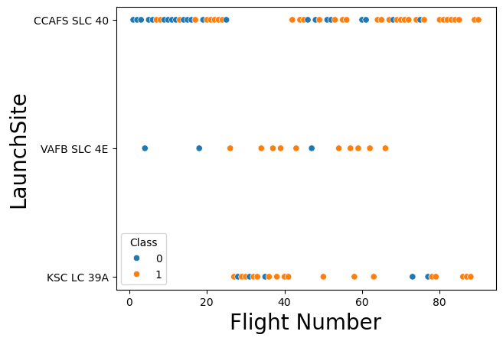
Flight Number vs. Launch Site
Scatter plot of Flight Number vs. Launch Site:
As visible the launch site KSC LC 39A has much better success rate than the other 2

Slide 19
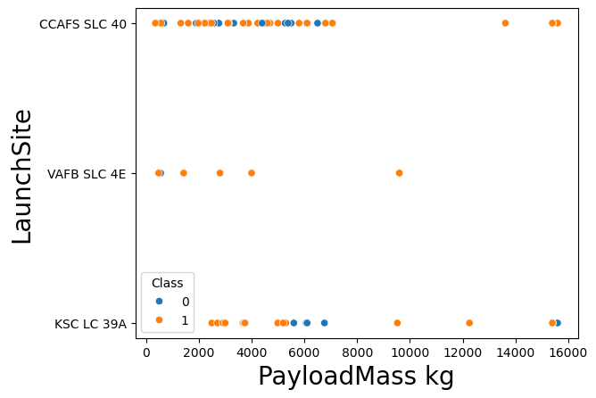
Payload vs. Launch Site
Scatter plot of Payload vs. Launch Site:
The payload had no effect on the launch success at all.

Slide 20
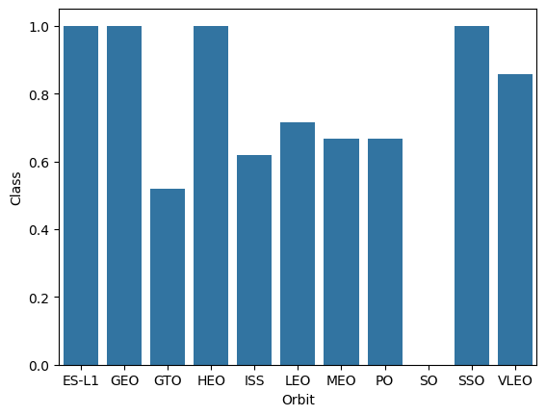
Success Rate vs. Orbit Type
Bar chart for the success rate of each orbit type:
The SO orbit has the least success rate followed by the GTO orbit. Other orbits seem more stable.(<60%)

Slide 21
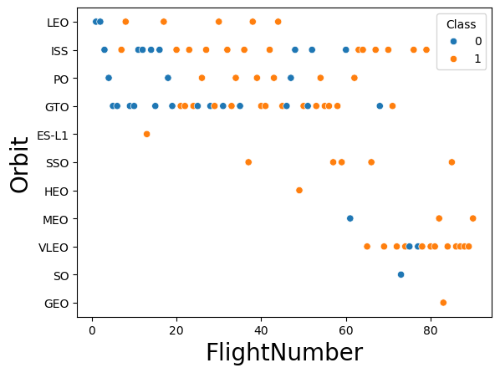
Flight Number vs. Orbit Type
Scatter point of Flight number vs. Orbit type:
The LEO orbits success apears related to the number of flights althoght no other realations can be found.

Slide 22
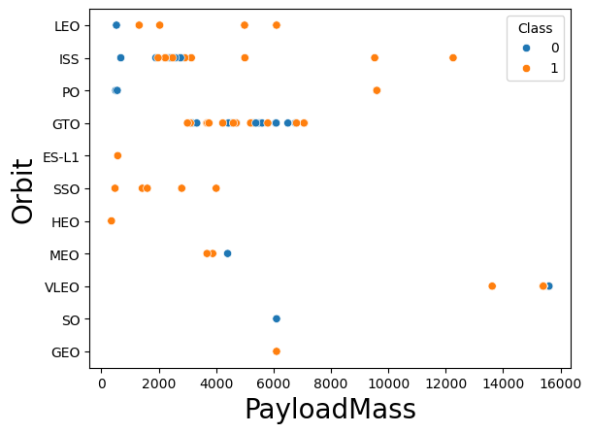
Payload vs. Orbit Type
Scatter point of payload vs. orbit type:
With heavy payloads the successful landing or positive landing rate are more for Polar, LEO and ISS.

Slide 23
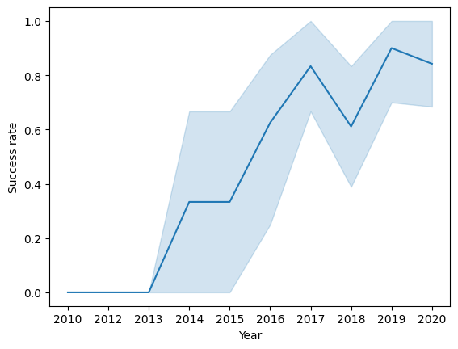
Launch Success Yearly Trend
Line chart of yearly average success rate:
Since 2013 the success rate has increased untill 2020.

Slide 24
All Launch Site Names
Find the names of the unique launch sites
The query: %sql SELECT DISTINCT("Launch_Site") FROM SPACEXTABLE
Launch_Site
CCAFS LC-40
VAFB SLC-4E
KSC LC-39A
CCAFS SLC-40

Slide 25
Launch Site Names Begin with 'CCA'
Find 5 records where launch sites begin with `CCA`
%sql SELECT * FROM SPACEXTABLE WHERE "Launch_Site" like 'CCA%' LIMIT(5)
Date | Time (UTC) | Booster_Version | Launch_Site | Payload | PAYLOAD_MASS__KG_ | Orbit | Customer | Mission_Outcome | Landing_Outcome
2010-06-04 | 18:45:00 | F9 v1.0 B0003 | CCAFS LC-40 | Dragon Spacecraft Qualification Unit | 0 | LEO | SpaceX | Success | Failure (parachute)
2010-12-08 | 15:43:00 | F9 v1.0 B0004 | CCAFS LC-40 | Dragon demo flight C1, two CubeSats, barrel of Brouere cheese | 0 | LEO (ISS) | NASA (COTS) NRO | Success | Failure (parachute)
2012-05-22 | 7:44:00 | F9 v1.0 B0005 | CCAFS LC-40 | Dragon demo flight C2 | 525 | LEO (ISS) | NASA (COTS) | Success | No attempt
2012-10-08 | 0:35:00 | F9 v1.0 B0006 | CCAFS LC-40 | SpaceX CRS-1 | 500 | LEO (ISS) | NASA (CRS) | Success | No attempt
2013-03-01 | 15:10:00 | F9 v1.0 B0007 | CCAFS LC-40 | SpaceX CRS-2 | 677 | LEO (ISS) | NASA (CRS) | Success | No attempt

Slide 26
Total Payload Mass
Calculate the total payload carried by boosters from NASA
%sql SELECT COUNT("PAYLOAD_MASS__KG_") FROM SPACEXTABLE WHERE "Customer" LIKE '%NASA%’
COUNT("PAYLOAD_MASS__KG_")
32

Slide 27
Average Payload Mass by F9 v1.1
Calculate the average payload mass carried by booster version F9 v1.1
%sql SELECT AVG("PAYLOAD_MASS__KG_") FROM SPACEXTABLE WHERE "Booster_Version" LIKE 'F9 v1.1%'
AVG("PAYLOAD_MASS__KG_")
2534.6666666666665

Slide 28
First Successful Ground Landing Date
Find the dates of the first successful landing outcome on ground pad
%sql SELECT DATE FROM SPACEXTABLE ORDER BY DATE asc LIMIT 1
Date
2010-06-04

Slide 29
Successful Drone Ship Landing with Payload between 4000 and 6000
List the names of boosters which have successfully landed on drone ship and had payload mass greater than 4000 but less than 6000
%sql SELECT "Booster_Version" FROM SPACEXTABLE WHERE "Landing_Outcome" = 'Success (drone ship)' AND "PAYLOAD_MASS__KG_" BETWEEN 4000 AND 6000
Booster_Version
F9 FT B1022
F9 FT B1026
F9 FT B1021.2
F9 FT B1031.2

Slide 30
Total Number of Successful and Failure Mission Outcomes
Calculate the total number of successful and failure mission outcomes
%sql SELECT "Landing_Outcome", COUNT("Landing_Outcome") FROM SPACEXTABLE GROUP BY "Landing_Outcome"
Landing_Outcome | COUNT("Landing_Outcome")
Controlled (ocean) | 5
Failure | 3
Failure (drone ship) | 5
Failure (parachute) | 2
No attempt | 21
No attempt | 1
Precluded (drone ship) | 1
Success | 38
Success (drone ship) | 14
Success (ground pad) | 9
Uncontrolled (ocean) | 2

Slide 31
Boosters Carried Maximum Payload
Date | Time (UTC) | Booster_Version | Launch_Site | Payload | PAYLOAD_MASS__KG_ | Orbit | Customer | Mission_Outcome | Landing_Outcome
2019-11-11 | 14:56:00 | F9 B5 B1048.4 | CCAFS SLC-40 | Starlink 1 v1.0, SpaceX CRS-19 | 15600 | LEO | SpaceX | Success | Success
2020-01-07 | 2:33:00 | F9 B5 B1049.4 | CCAFS SLC-40 | Starlink 2 v1.0, Crew Dragon in-flight abort test | 15600 | LEO | SpaceX | Success | Success
2020-01-29 | 14:07:00 | F9 B5 B1051.3 | CCAFS SLC-40 | Starlink 3 v1.0, Starlink 4 v1.0 | 15600 | LEO | SpaceX | Success | Success
2020-02-17 | 15:05:00 | F9 B5 B1056.4 | CCAFS SLC-40 | Starlink 4 v1.0, SpaceX CRS-20 | 15600 | LEO | SpaceX | Success | Failure
2020-03-18 | 12:16:00 | F9 B5 B1048.5 | KSC LC-39A | Starlink 5 v1.0, Starlink 6 v1.0 | 15600 | LEO | SpaceX | Success | Failure
2020-04-22 | 19:30:00 | F9 B5 B1051.4 | KSC LC-39A | Starlink 6 v1.0, Crew Dragon Demo-2 | 15600 | LEO | SpaceX | Success | Success
2020-06-04 | 1:25:00 | F9 B5 B1049.5 | CCAFS SLC-40 | Starlink 7 v1.0, Starlink 8 v1.0 | 15600 | LEO | SpaceX, Planet Labs | Success | Success
2020-09-03 | 12:46:14 | F9 B5 B1060.2 | KSC LC-39A | Starlink 11 v1.0, Starlink 12 v1.0 | 15600 | LEO | SpaceX | Success | Success
2020-10-06 | 11:29:34 | F9 B5 B1058.3 | KSC LC-39A | Starlink 12 v1.0, Starlink 13 v1.0 | 15600 | LEO | SpaceX | Success | Success
2020-10-18 | 12:25:57 | F9 B5 B1051.6 | KSC LC-39A | Starlink 13 v1.0, Starlink 14 v1.0 | 15600 | LEO | SpaceX | Success | Success
2020-10-24 | 15:31:34 | F9 B5 B1060.3 | CCAFS SLC-40 | Starlink 14 v1.0, GPS III-04 | 15600 | LEO | SpaceX | Success | Success
2020-11-25 | 2:13:00 | F9 B5 B1049.7 | CCAFS SLC-40 | Starlink 15 v1.0, SpaceX CRS-21 | 15600 | LEO | SpaceX | Success | Success
List the names of the booster which have carried the maximum payload mass
%sql SELECT * FROM SPACEXTABLE WHERE "PAYLOAD_MASS__KG_" = (SELECT MAX("PAYLOAD_MASS__KG_")FROM SPACEXTABLE)

Slide 32
2015 Launch Records
List the failed landing_outcomes in drone ship, their booster versions, and launch site names for in year 2015
%sql SELECT substr(Date, 6,2), "Booster_Version", "Launch_Site" FROM SPACEXTABLE WHERE substr(Date,0,5)='2015' AND "Landing_Outcome" = 'Failure (drone ship)'
substr(Date, 6,2) | Booster_Version | Launch_Site
01 | F9 v1.1 B1012 | CCAFS LC-40
04 | F9 v1.1 B1015 | CCAFS LC-40

Slide 33
Rank Landing Outcomes Between 2010-06-04 and 2017-03-20
Rank the count of landing outcomes (such as Failure (drone ship) or Success (ground pad)) between the date 2010-06-04 and 2017-03-20, in descending order
SELECT landing_outcome, COUNT(*) as outcome_count FROM launches WHERE launch_date BETWEEN '2010-06-04' AND '2017-03-20'GROUP BY landing_outcome ORDER BY outcome_count DESC;

Slide 34

Section 3

Slide 35
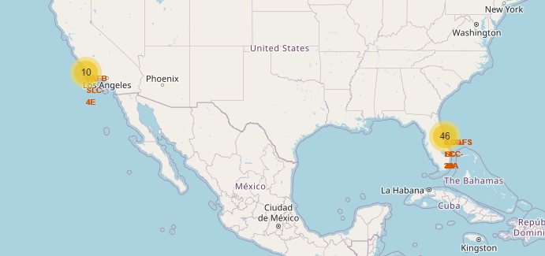
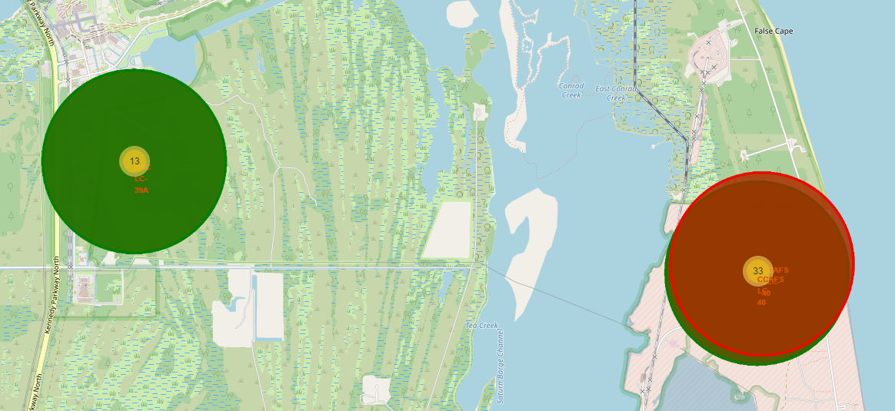
<Folium Map Screenshot 1>
From the color-labeled markers in marker clusters, we are able to easily identify which launch sites have relatively high success rates.

Slide 36
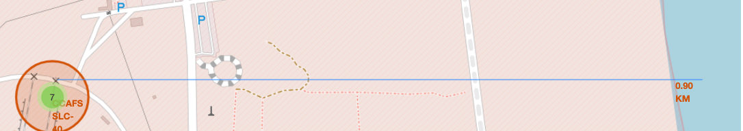
<Folium Map Screenshot 2>

Slide 37
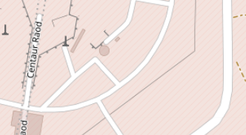
<Folium Map Screenshot 3>

Slide 38

Section 4

Slide 39
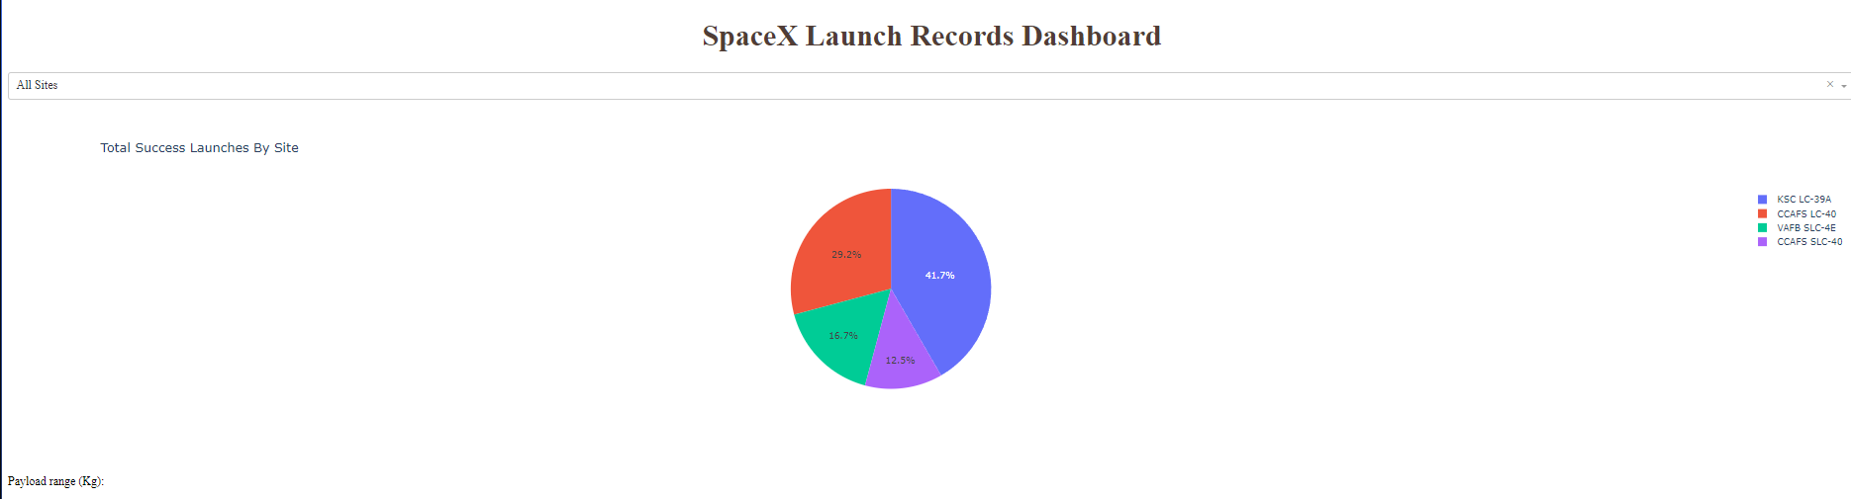
<Dashboard Screenshot 1>

Slide 40
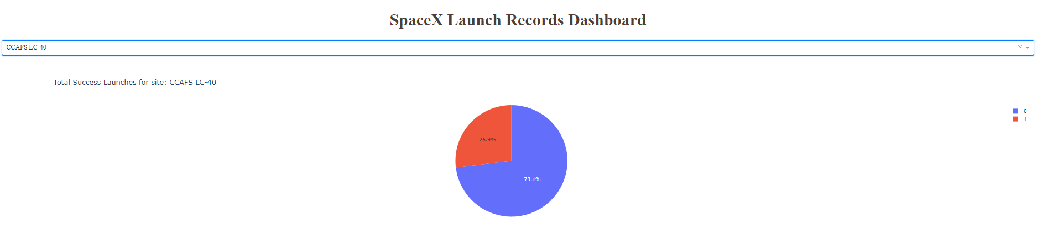
<Dashboard Screenshot 2>

Slide 41
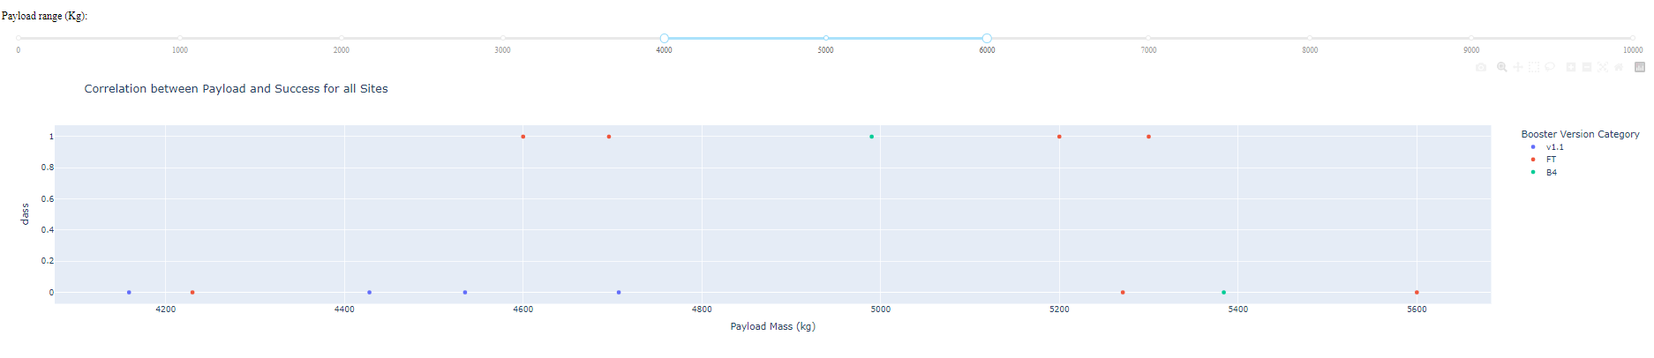
<Dashboard Screenshot 3>

Slide 42

Section 5

Slide 43
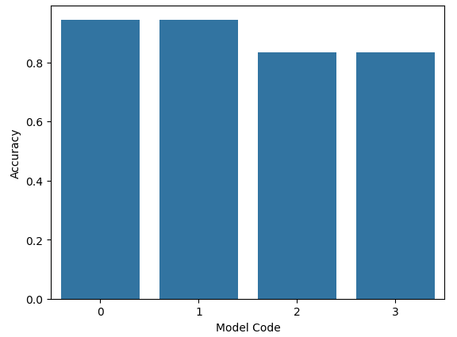
Classification Accuracy

Slide 44
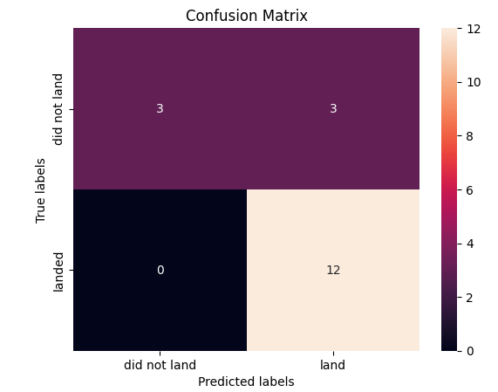
Confusion Matrix

Slide 45
Conclusions
E
L
O
N
M
U
S
K

Slide 46
Appendix

Slide 47


